Slide 1


Noida Institute of Engineering and Technology, Greater Noida
KCS 501
Database Management System
Unit: 4
Transaction Processing Concept
Ram Kumar Sharma
Assistant Prof. IT Deptt.
NIET Gr Noida
B.Tech. (IT) 5th Sem

Slide 2
Content
Syllabus of Unit 4
Course Objective of Unit 4
Course outcome of Unit 4
CO-PO mapping
CO PSO mapping
Prerequisite and Recap
Transaction concept & State
Implementation of atomicity and durability
Serializability
Conflict Serializability
View Serializability
Schedule
Non-serializable schedule
Recoverable schedule
Irrecoverable schedule

Slide 3
Content
Types of Recoverable Schedules
Cascadeless Schedules
Strict Schedule
Recovery and Atomicity
Recovery Algorithms
Log-Based Recovery
Deferred database modification
Immediate database modification
Checkpoints
Deadlock
Deadlock Avoidance
Deadlock Detection
Deadlock Prevention
Distributed Database
Directory System

Slide 4
Content
Faculty Video Links, Youtube & NPTEL Video Links and Online Courses Details
MCQ
Weekly Assignment 4.1
Old Question Papers
Expected Questions for University Exam
References

Slide 5
Syllabus of Unit 4
Transaction Processing Concept: Transaction System, Testing of Serializability, Serializability of Schedules, Conflict & View Serializable Schedule, Recoverability, Recovery from Transaction Failures, Log Based Recovery, Checkpoints, Deadlock Handling. Distributed Database: Distributed Data Storage, Concurrency Control, Directory System.

Slide 6
Course Objective
Explain basic issues of transaction processing and concurrency control.
Apply the RDBMS concepts in transaction.

Slide 7
Course Outcomes
At the end of semester students will be able
CO4 | Understand the concepts of transactions, their processing so they will familiar with broad range of database management issues including data integrity, security and recovery

Slide 8
CO-PO Mapping
co-po correlation matrix
co.k | po1 | po2 | po3 | po4 | po5 | po6 | po7 | po8 | po9 | po10 | po11 | po12
KCS-501.4 | 2 | 3 | 2 | 2 | 2 | 2 | 2 | 2 | 2 | 3 | 2 | 2

Slide 9
CO-PO Mapping
co.k | pso1 | pso2 | pso3 | pso4
KCS-501.4 | 2 | 2 | 3 | 2

Slide 10
Prerequisite and Recap
SQL
Concepts of Relational Data base design
Knowledge of Process management
Operating system

Slide 11
Content unit 4 (Lecture 20,21,22,23,24,25)
Transaction concept & State
Implementation of atomicity and durability
Serializability
Conflict Serializability
View Serializability
Schedule
Non-serializable schedule
Recoverable schedule
Irrecoverable schedule
Types of Recoverable Schedules
Cascadeless Schedules
Strict Schedule

Slide 12
Prerequisite Unit 4 Lect. 20,21,22
Operating system
SQL
Concepts of Relational Data base design
Knowledge of Process management

Slide 13
Topic mapping with CO
Topic | CO
Transaction concept & State Implementation of atomicity and durability | CO4
Serializability Conflict Serializability View Serializability Schedule Non-serializable schedule Recoverable schedule Irrecoverable schedule | CO4
Types of Recoverable Schedules | CO4
Cascade less Schedules Strict Schedule | CO4

Slide 14
Topic Objectives
Topic | Objectives
Transaction concept & State Implementation of atomicity and durability | Students will be able to learn transaction properties
Serializability Conflict Serializability View Serializability Schedule Non-serializable schedule Recoverable schedule Irrecoverable schedule | Students will be able to understand the concept of serializability and can analyse the given schedule
Types of Recoverable Schedules | Students will be able to find if schedule is recoverable or not in case of transaction failure
Cascade less Schedules Strict Schedule | Students will be able to find if given schedules are casecadeless schedule or not

Slide 15
Transaction Concept (CO4)
A transaction is a unit of program execution that accesses and possibly updates various data items.
E.g. transaction to transfer $50 from account A to account B:
1. read(A)
2. A := A – 50
3. write(A)
4. read(B)
5. B := B + 50
6. write(B)
Two main issues to deal with:
Failures of various kinds, such as hardware failures and system crashes
Concurrent execution of multiple transactions

Slide 16
Example of Fund Transfer (CO4)
Transaction to transfer $50 from account A to account B:
1. read(A)
2. A := A – 50
3. write(A)
4. read(B)
5. B := B + 50
6. write(B)
Atomicity requirement
if the transaction fails after step 3 and before step 6, money will be “lost” leading to an inconsistent database state
Failure could be due to software or hardware
the system should ensure that updates of a partially executed transaction are not reflected in the database

Slide 17
Example of Fund Transfer (CO4) (cont..)
Durability requirement
the updates to the database by the transaction must persist even if there are software or hardware failures.
Isolation requirement T1 T2
1. read(A)
2. A := A – 50
3. write(A) read(A), read(B), print(A+B)
4. read(B)
5. B := B + 50
6. write(B
Isolation can be ensured trivially by running transactions serially
that is, one after the other.
However, executing multiple transactions concurrently has significant benefits, as we will see later.

Slide 18
ACID Properties (CO4)
Transaction -- unit of program execution that accesses and possibly updates
Atomicity. Either all operations of the transaction are properly reflected in the database or none are.
Consistency. Execution of a transaction in isolation preserves the consistency of the database.
Isolation. Although multiple transactions may execute concurrently, each transaction must be unaware of other concurrently executing transactions.
That is, for every pair of transactions T_{i} and T_{j}, it appears to T_{i} that either T_{j}, finished execution before T_{i} started, or T_{j} started execution after T_{i} finished.
Durability. After a transaction completes successfully, the changes it has made to the database persist, even if there are system failures.

Slide 19
Transaction State (CO4)
Active – the initial state; the transaction stays in this state while it is executing
Partially committed – after the final statement has been executed.
Failed -- after the discovery that normal execution can no longer proceed.
Aborted – after the transaction has been rolled back and the database restored to its state prior to the start of the transaction. Two options after it has been aborted:
restart the transaction
can be done only if no internal logical error
kill the transaction
Committed – after successful completion.

Slide 20
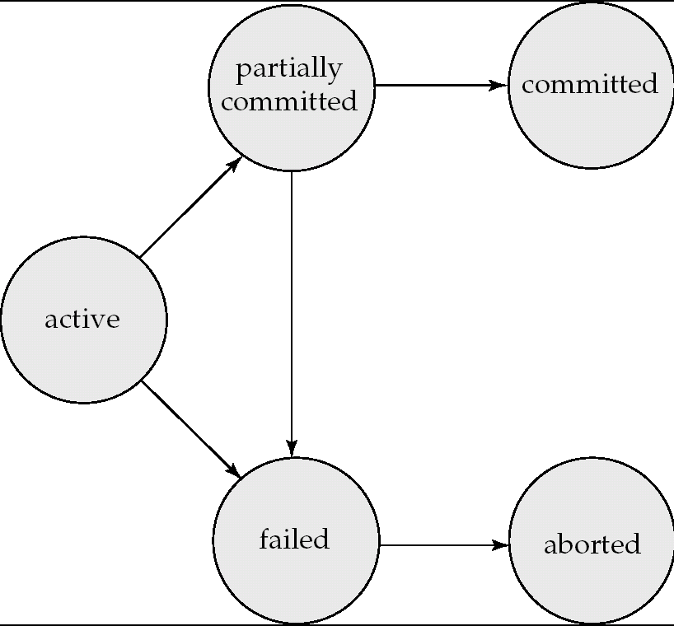
Transaction State (Cont.)(CO4)

Slide 21
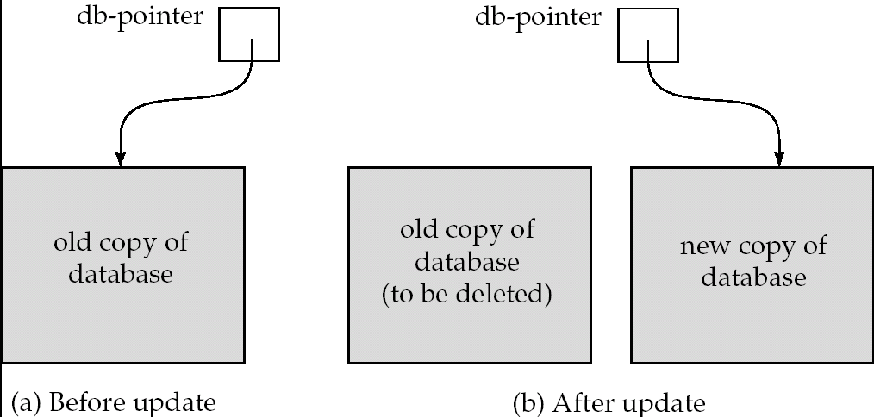
Implementation of Atomicity and Durability (CO4)
The recovery-management component of a database system implements the support for atomicity and durability.
E.g. the shadow-database scheme:
all updates are made on a shadow copy of the database
db_pointer is made to point to the updated shadow copy after
the transaction reaches partial commit and
all updated pages have been flushed to disk.

Slide 22
Concurrent Executions (CO4)
Multiple transactions are allowed to run concurrently in the system. Advantages are:
increased processor and disk utilization, leading to better transaction throughput
E.g. one transaction can be using the CPU while another is reading from or writing to the disk
reduced average response time for transactions: short transactions need not wait behind long ones.
Concurrency control schemes – mechanisms to achieve isolation
that is, to control the interaction among the concurrent transactions in order to prevent them from destroying the consistency of the database
Will study, after studying notion of correctness of concurrent executions.

Slide 23
Schedules (CO4)
Schedule – a sequences of instructions that specify the chronological order in which instructions of concurrent transactions are executed.
a schedule for a set of transactions must consist of all instructions of those transactions
must preserve the order in which the instructions appear in each individual transaction.

Slide 24
Serializability (CO4)
Basic Assumption
Each transaction preserves database consistency.
Thus serial execution of a set of transactions preserves database consistency.
A (possibly concurrent) schedule is serializable if it is equivalent to a serial schedule.
Different forms of schedule equivalence give rise to the notions of:
1. conflict serializability
2. view serializability

Slide 25
Conflicting Instructions (CO4)
Instructions l_{i} and l_{j} of transactions T_{i} and T_{j} respectively, conflict if and only if there exists some item Q accessed by both l_{i} and l_{j}, and at least one of these instructions wrote Q.
1. l_{i} = read(Q), l_{j} = read(Q). l_{i} and l_{j} don’t conflict. 2. l_{i} = read(Q), l_{j} = write(Q). They conflict. 3. l_{i} = write(Q), l_{j} = read(Q). They conflict 4. l_{i} = write(Q), l_{j} = write(Q). They conflict
Intuitively, a conflict between l_{i} and l_{j} forces a (logical) temporal order between them.
If l_{i} and l_{j} are consecutive in a schedule and they do not conflict, their results would remain the same even if they had been interchanged in the schedule.

Slide 26
Conflict Serializability (CO4)
If a schedule S can be transformed into a schedule S´ by a series of swaps of non-conflicting instructions, we say that S and S´ are conflict equivalent.
We say that a schedule S is conflict serializable if it is conflict equivalent to a serial schedule

Slide 27
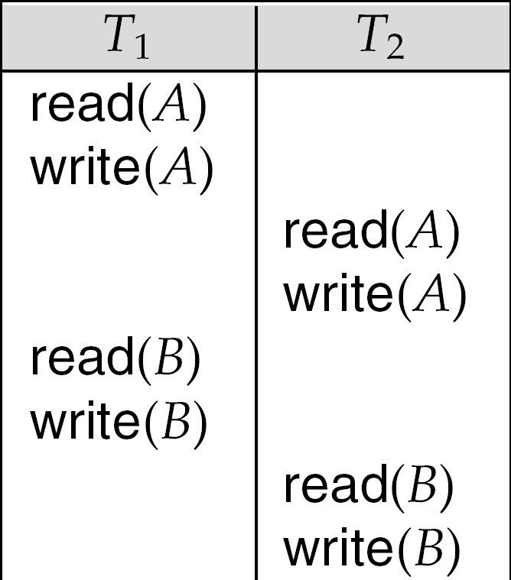
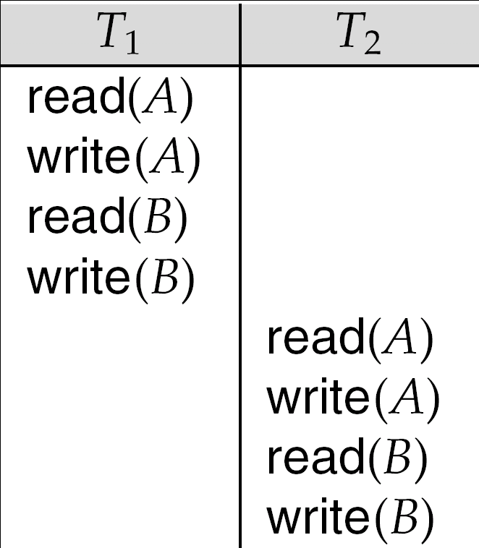
Conflict Serializability (cont..) (CO4)
Schedule 3 can be transformed into Schedule 6, a serial schedule where T₂ follows T₁, by series of swaps of non-conflicting instructions.
Therefore Schedule 3 is conflict serializable.
Schedule 3
Schedule 6

Slide 28
Checking Whether a Schedule is Conflict Serializable Or Not (CO4)
Follow the following steps to check whether a given non-serial schedule is conflict serializable or not-
Step-01:Find and list all the conflicting operations.
Step-02: Start creating a precedence graph by drawing one node for each transaction.
Step-03:Draw an edge for each conflict pair such that if X_{i} (V) and Y_{j} (V) forms a conflict pair then draw an edge from T_{i} to T_{j}.This ensures that T_{i} gets executed before T_{j}.
Step-04: Check if there is any cycle formed in the graph. If there is no cycle found, then the schedule is conflict serializable otherwise not.

Slide 29
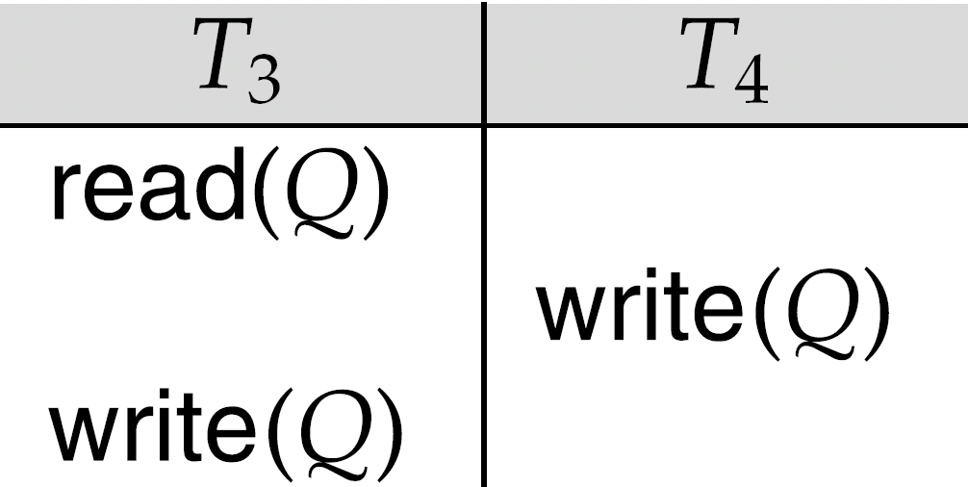
Conflict Serializability (Cont.) (CO4)
Example of a schedule that is not conflict serializable: We are unable to swap instructions in the above schedule to obtain either the serial schedule < T₃, T₄ >, or the serial schedule < T₄, T₃ >.

Slide 30
Daily Quiz (CO4)
PROBLEMS BASED ON CONFLICT SERIALIZABILITY-
Problem-01: Check whether the given schedule S is conflict serializable or not- S : R₁(A) , R₂(A) , R₁(B) , R₂(B) , R₃(B) , W₁(A) , W₂(B) Solution-
Step-01:
List all the conflicting operations and determine the dependency between the transactions-
R₂(A) , W₁(A) (T₂ → T₁)
R₁(B) , W₂(B) (T₁ → T₂)
R₃(B) , W₂(B) (T₃ → T₂)

Slide 31
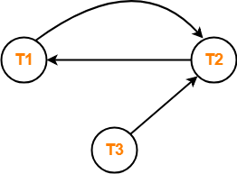
Daily Quiz (CO4)
Step-02:
Draw the precedence graph-
Clearly, there exists a cycle in the precedence graph.
Therefore, the given schedule S is not conflict serializable.

Slide 32
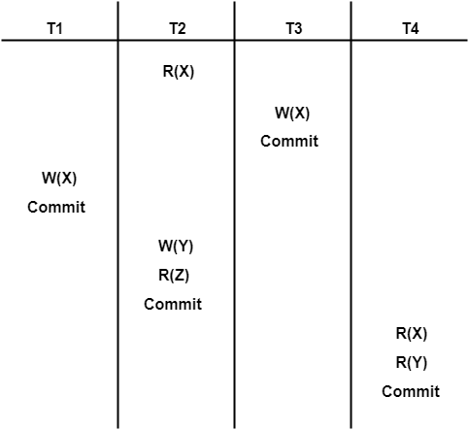
Problem-02: Check whether the given schedule S is conflict serializable and recoverable or not-
Daily Quiz (CO4)
PROBLEMS BASED ON CONFLICT SERIALIZABILITY-
Solution-
Checking Whether S is Conflict Serializable Or Not-
Step-01:
List all the conflicting operations and determine the dependency between the transactions-
R₂(X) , W₃(X) (T₂ → T₃)
R₂(X) , W₁(X) (T₂ → T₁)
W₃(X) , W₁(X) (T₃ → T₁)
W₃(X) , R₄(X) (T₃ → T₄)
W₁(X) , R₄(X) (T₁ → T₄)
W₂(Y) , R₄(Y) (T₂ → T₄)

Slide 33
Problem-02: Check whether the given schedule S is conflict serializable and recoverable or not-
Daily Quiz (CO4)
PROBLEMS BASED ON CONFLICT SERIALIZABILITY-
Solution-
Checking Whether S is Conflict Serializable Or Not-
Step-01:
List all the conflicting operations and determine the dependency between the transactions-
R₂(X) , W₃(X) (T₂ → T₃)
R₂(X) , W₁(X) (T₂ → T₁)
W₃(X) , W₁(X) (T₃ → T₁)
W₃(X) , R₄(X) (T₃ → T₄)
W₁(X) , R₄(X) (T₁ → T₄)
W₂(Y) , R₄(Y) (T₂ → T₄)

Slide 34
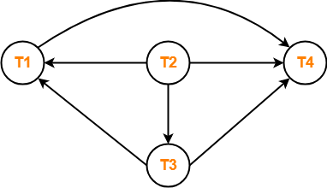
Checking Whether a Schedule is Conflict Serializable Or Not contd.. (CO4)
Step-02:
Draw the precedence graph-
Clearly, there exists no cycle in the precedence graph.
Therefore, the given schedule S is conflict serializable.
Checking Whether S is Recoverable Or Not-
Conflict serializable schedules are always recoverable.
Therefore, the given schedule S is recoverable.

Slide 35
Finding the Serialized Schedules-(CO4)
All the possible topological orderings of the above precedence graph will be the possible serialized schedules.
The topological orderings can be found by performing the Topological Sort of the above precedence graph.
After performing the topological sort, the possible serialized schedules are-
T₁ → T₃ → T₄ → T₂
T₁ → T₄ → T₃ → T₂
T₄ → T₁ → T₃ → T₂

Slide 36
View Serializability (CO4)
Let S and S´ be two schedules with the same set of transactions. S and S´ are view equivalent if the following three conditions are met, for each data item Q,
1. If in schedule S, transaction T_{i} reads the initial value of Q, then in schedule S’ also transaction T_{i} must read the initial value of Q.
Thumb Rule
“Initial readers must be same for all the data items”.
2. If in schedule S transaction T_{i} executes read(Q), and that value was produced by transaction T_{j} (if any), then in schedule S’ also transaction T_{i} must read the value of Q that was produced by the same write(Q) operation of transaction T_{j} .
Thumb Rule
“Write-read sequence must be same.”

Slide 37
View Serializability (contd..) (CO4)
3. The transaction (if any) that performs the final write(Q) operation in schedule S must also perform the final write(Q) operation in schedule S’.
Thumb Rule
“Final writers must be same for all the data items”

Slide 38
Checking Whether a Schedule is View Serializable Or Not (CO4)
Method-01:
Check whether the given schedule is conflict serializable or not.
If the given schedule is conflict serializable, then it is surely view serializable.
If the given schedule is not conflict serializable, then it may or may not be view serializable. Go and check using other methods.
Thumb Rules
All conflict serializable schedules are view serializable.
All view serializable schedules may or may not be conflict serializable.

Slide 39
Method-02:
Checking Whether a Schedule is View Serializable Or Not (CO4)
Check if there exists any blind write operation.
Writing without reading is called as a blind write
If there does not exist any blind write, then the schedule is surely not view serializable.
If there exists any blind write, then the schedule may or may not be view serializable. Go and check using other methods.
Thumb Rule
No blind write means not a view serializable schedule.

Slide 40
Method-03:
Checking Whether a Schedule is View Serializable Or Not (CO4)
in this method, try finding a view equivalent serial schedule.
By using the above three conditions, write all the dependencies.
Then, draw a graph using those dependencies.
If there exists no cycle in the graph, then the schedule is view serializable otherwise not.

Slide 41
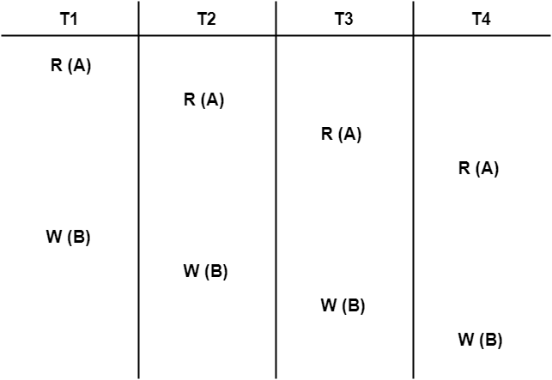
PROBLEMS BASED ON VIEW SERIALIZABILITY (CO4)
Problem-01
Check whether the given schedule S is view serializable or not-

Slide 42
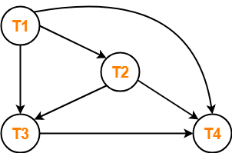
Solution-
PROBLEMS BASED ON VIEW SERIALIZABILITY (CO4)
Checking Whether S is Conflict Serializable Or Not-
Step-01:
List all the conflicting operations and determine the dependency between the transactions-
W₁(B) , W₂(B) (T₁ → T₂)
W₁(B) , W₃(B) (T₁ → T₃)
W₁(B) , W₄(B) (T₁ → T₄)
W₂(B) , W₃(B) (T₂ → T₃)
W₂(B) , W₄(B) (T₂ → T₄)
W₃(B) , W₄(B) (T₃ → T₄)
Step-02:
Draw the precedence graph-
Clearly, there exists no cycle in the precedence graph.
Therefore, the given schedule S is conflict serializable.
Thus, we conclude that the given schedule is also view serializable.

Slide 43
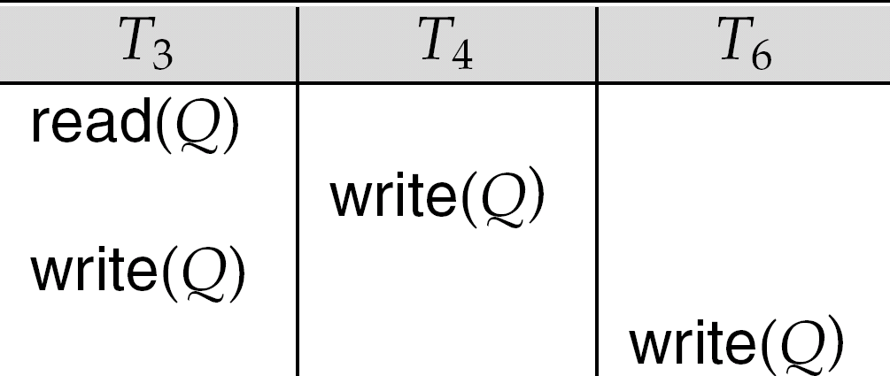
View Serializability (Cont.) (CO4)
A schedule S is view serializable if it is view equivalent to a serial schedule.
Every conflict serializable schedule is also view serializable.
Below is a schedule which is view-serializable but not conflict serializable.
What serial schedule is above equivalent to?
Every view serializable schedule that is not conflict serializable has blind writes.

Slide 44
View Serializability (Cont.) (CO4)
Q. Check the view serializabilty
Schedule = w3(x),r2(x),w2(y),r1(z),w3(y),w1(y)

Slide 45
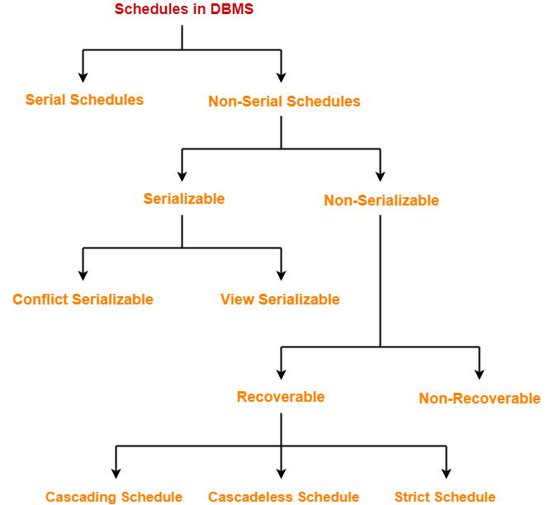
Schedule (CO4)

Slide 46
Non-serializable schedule (CO4)
A non-serial schedule which is not serializable is called as a non-serializable schedule.
A non-serializable schedule is not guaranteed to produce the same effect as produced by some serial schedule on any consistent database.
Note:
Non-serializable schedules-
may or may not be consistent
may or may not be recoverable

Slide 47
Recoverable schedule (CO4)
if a transaction T_{j} reads a data item previously written by a transaction T_{i} , then the commit operation of T_{i} appears before the commit operation of T_{j}.
Example :
S1: R1(x), W1(x), R2(x), R1(y), R2(y), W2(x), W1(y), C1, C2;

Slide 48
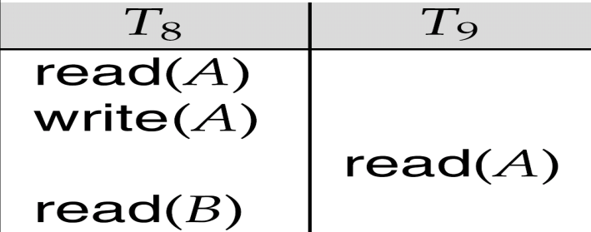
Irrecoverable schedule (CO4)
If in a schedule,
A transaction performs a dirty read operation from an uncommitted transaction
(Reading from an uncommitted transaction is called as a dirty read)
And commits before the transaction from which it has read the value
then such a schedule is known as an Irrecoverable Schedule.
The following schedule is not recoverable if T₉ commits immediately after the read

Slide 49
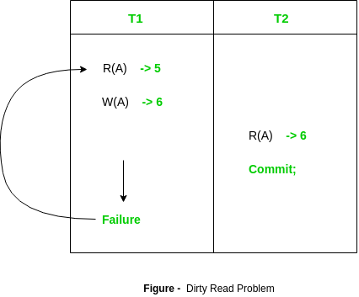
Irrecoverable schedule (CO4)
S2: R1(x), R2(x), R1(z), R3(x), R3(y), W1(x), W3(y), R2(y), W2(z), W2(y), C1, C2, C3;

Slide 50
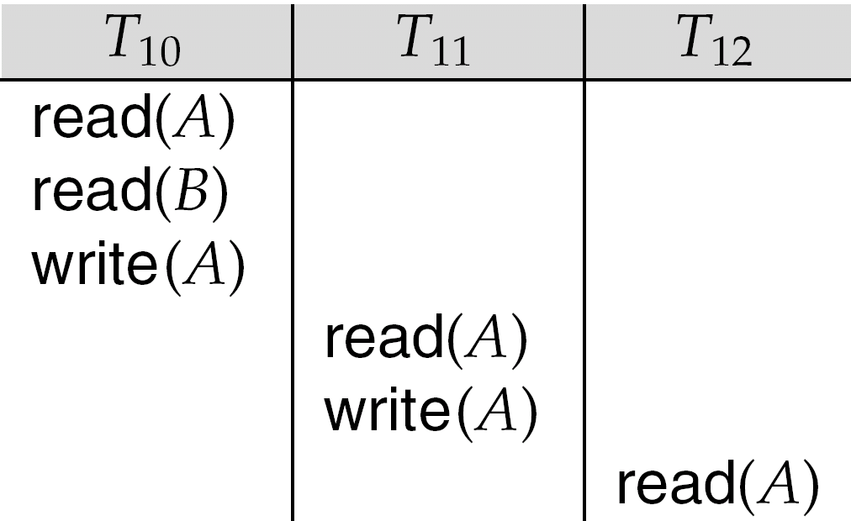
Types of Recoverable Schedules (CO4)
A recoverable schedule may be any one of these kinds-
Cascading Schedule
Cascadeless Schedule
Strict Schedule
Cascading Schedule-
If in a schedule, failure of one transaction causes several other dependent transactions to rollback or abort, then such a schedule is called as a Cascading Schedule or Cascading Rollback or Cascading Abort.
It simply leads to the wastage of CPU time.
If T₁₀ fails, T₁₁ and T₁₂ must also be rolled back.
lead to the undoing of a significant amount of work

Slide 51
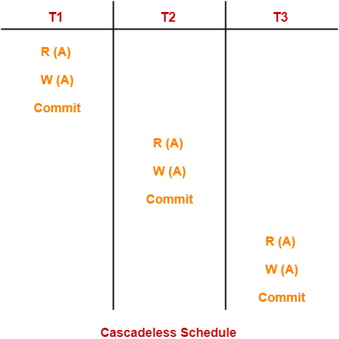
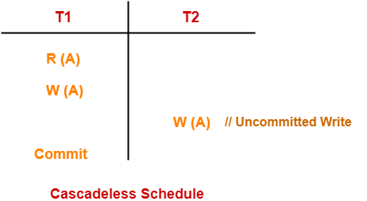
Cascadeless Schedules (CO4)
If in a schedule, a transaction is not allowed to read a data item until the last transaction that has written it is committed or aborted, then such a schedule is called as a Cascadeless Schedule.
In other words,
Cascadeless schedule allows only committed read operations.
Therefore, it avoids cascading roll back and thus saves CPU time.

Slide 52
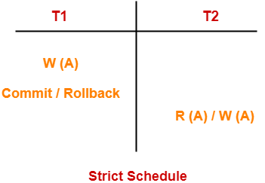
Strict Schedule (CO4)
If in a schedule, a transaction is neither allowed to read nor write a data item until the last transaction that has written it is committed or aborted, then such a schedule is called as a Strict Schedule.
In other words,
Strict schedule allows only committed read and write operations.
Clearly, strict schedule implements more restrictions than cascadeless schedule.

Slide 53
MCQ
1. Which of the following systems is responsible for ensuring durability? a) Recovery system b) Atomic system c) Concurrency control system d) Compiler system
2. Which of the following systems is responsible for ensuring isolation? a) Recovery system b) Atomic system c) Concurrency control system d) Compiler system
3. A transaction that has not been completed successfully is called as _______ a) Compensating transaction b) Aborted transaction c) Active transaction d) Partially committed transaction
4. The scheme that controls the interaction between executing transactions is called as _____ a) Concurrency control scheme b) Multiprogramming scheme c) Serialization scheme d) Schedule scheme

Slide 54
Content unit 4 (Lecture 26,27,28,29,30)
Recovery and Atomicity
Recovery Algorithms
Log-Based Recovery
Deferred database modification
Immediate database modification
Checkpoints
Deadlock
Deadlock Avoidance
Deadlock Detection
Deadlock Prevention
Distributed Database
Directory System

Slide 55
Prerequisite Unit 4 Lect. 26,27,28,29,30
Operating system
SQL

Slide 56
Topic mapping with CO
Topic | CO
Recovery and Atomicity Recovery Algorithms | CO4
Log-Based Recovery Deferred database modification Immediate database modification | CO4
Checkpoints Deadlock Deadlock Avoidance Deadlock Detection Deadlock Prevention | CO4
Distributed Database Directory System and durability | CO4

Slide 57
Topic Objectives
Topic | Objectives
Recovery and Atomicity Recovery Algorithms | Students will be able to learn how to recover a transaction in case of failure
Log-Based Recovery Deferred database modification Immediate database modification | Students will be able to understand the concept of log based recovery
Checkpoints Deadlock Deadlock Avoidance Deadlock Detection Deadlock Prevention | Students will be able to find the solution for uncompleted schedule of transactions
Distributed Database Directory System | Students will be able to learn the distributed system architecture

Slide 58
Database Recovery
the process of restoring the database to the most recent consistent state that existed just before the failure

Slide 59
Recovery and Atomicity (CO4)
Modifying the database without ensuring that the transaction will commit may leave the database in an inconsistent state.
Consider transaction T_{i} that transfers $50 from account A to account B; goal is either to perform all database modifications made by T_{i} or none at all.
Several output operations may be required for T_{i} (to output A and B). A failure may occur after one of these modifications have been made but before all of them are made.

Slide 60
Recovery and Atomicity (CO4) cont..
To ensure atomicity despite failures, we first output information describing the modifications to stable storage without modifying the database itself.
We study two approaches:
log-based recovery, and
shadow-paging
We assume (initially) that transactions run serially, that is, one after the other.

Slide 61
Recovery Algorithms (CO4)
Recovery algorithms are techniques to ensure database consistency and transaction atomicity and durability despite failures
Recovery algorithms have two parts
Actions taken during normal transaction processing to ensure enough information exists to recover from failures
Actions taken after a failure to recover the database contents to a state that ensures atomicity, consistency and durability

Slide 62
Log-Based Recovery (CO4)
A log is kept on stable storage.
The log is a sequence of log records, and maintains a record of update activities on the database.
When transaction T_{i} starts, it registers itself by writing a <T_{i} start>log record
Before T_{i} executes write(X), a log record <T_{i}, X, V₁, V₂> is written, where V₁ is the value of X before the write, and V₂ is the value to be written to X.
Log record notes that T_{i} has performed a write on data item X_{j} X_{j} had value V₁ before the write, and will have value V₂ after the write.
When T_{i} finishes it last statement, the log record <T_{i} commit> is written.
We assume for now that log records are written directly to stable storage (that is, they are not buffered)

Slide 63
Log-Based Recovery (CO4) contd..
Two approaches using logs
Deferred database modification
Immediate database modification

Slide 64
Deferred Database Modification (CO4)
The deferred database modification scheme records all modifications to the log, but defers all the writes to after partial commit.
Assume that transactions execute serially
Transaction starts by writing <T_{i} start> record to log.
A write(X) operation results in a log record <T_{i}, X, V> being written, where V is the new value for X
Note: old value is not needed for this scheme
The write is not performed on X at this time, but is deferred.
When T_{i} partially commits, <T_{i} commit> is written to the log
Finally, the log records are read and used to actually execute the previously deferred writes.

Slide 65
Deferred Database Modification (CO4)
During recovery after a crash, a transaction needs to be redone if and only if both <T_{i} start> and<T_{i} commit> are there in the log.
Redoing a transaction T_{i} ( redoT_{i}) sets the value of all data items updated by the transaction to the new values.
Crashes can occur while
the transaction is executing the original updates, or
while recovery action is being taken
example transactions T₀ and T₁ (T₀ executes before T₁):
T₀: read (A) T₁ : read (C)
A: - A - 50 C:- C- 100
Write (A) write (C)
read (B)
B:- B + 50
write (B)

Slide 66
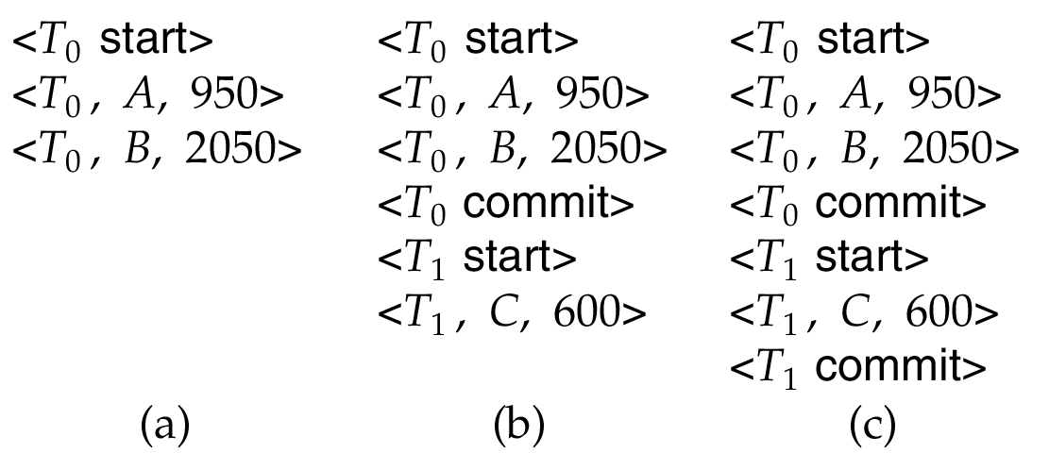
Deferred Database Modification (Cont.) (CO4)
Below we show the log as it appears at three instances of time.
If log on stable storage at time of crash is as in case:
(a) No redo actions need to be taken
(b) redo(T₀) must be performed since <T₀ commit> is present
(c) redo(T₀) must be performed followed by redo(T₁) since
<T₀ commit> and <T_{i} commit> are present

Slide 67
Immediate Database Modification (Cont.) (CO4)
The immediate database modification scheme allows database updates of an uncommitted transaction to be made as the writes are issued
since undoing may be needed, update logs must have both old value and new value
Update log record must be written before database item is written
We assume that the log record is output directly to stable storage
Can be extended to postpone log record output, so long as prior to execution of an output(B) operation for a data block B, all log records corresponding to items B must be flushed to stable storage

Slide 68
Immediate Database Modification (Cont.) (CO4)
Output of updated blocks can take place at any time before or after transaction commit
Order in which blocks are output can be different from the order in which they are written.
Recovery procedure has two operations instead of one:
undo(T_{i}) restores the value of all data items updated by T_{i} to their old values, going backwards from the last log record for T_{i}
redo(T_{i}) sets the value of all data items updated by T_{i} to the new values, going forward from the first log record for T_{i}

Slide 69
Immediate Database Modification (Cont.) (CO4)
Both operations must be idempotent
That is, even if the operation is executed multiple times the effect is the same as if it is executed once
Needed since operations may get re-executed during recovery
When recovering after failure:
Transaction T_{i} needs to be undone if the log contains the record <T_{i} start>, but does not contain the record <T_{i} commit>.
Transaction T_{i} needs to be redone if the log contains both the record <T_{i} start> and the record <T_{i} commit>.
Undo operations are performed first, then redo operations.

Slide 70
Immediate Database Modification (Cont.) (CO4)
Log Write Output
<T₀ start>
<T₀, A, 1000, 950>
T_{o}, B, 2000, 2050
A = 950
B = 2050
<T₀ commit>
<T₁ start>
<T₁, C, 700, 600>
C = 600
B_{B}, B_{C}
<T₁ commit>
B_{A}
Note: B_{X} denotes block containing X.

Slide 71
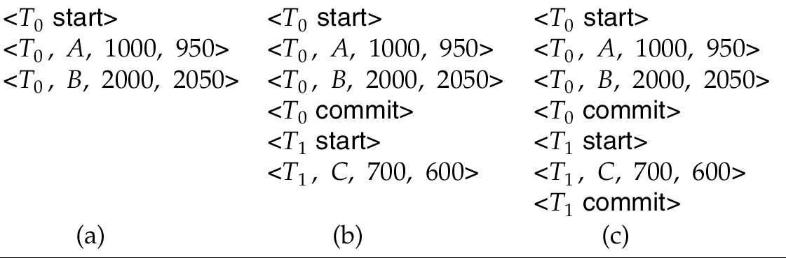
Immediate DB Modification Recovery Example (Cont.) (CO4)
Below we show the log as it appears at three instances of time.
Recovery actions in each case above are:
(a) undo (T₀): B is restored to 2000 and A to 1000.
(b) undo (T₁) and redo (T₀): C is restored to 700, and then A and B are
set to 950 and 2050 respectively.
(c) redo (T₀) and redo (T₁): A and B are set to 950 and 2050
respectively. Then C is set to 600

Slide 72
Checkpoints (CO4)
Problems in recovery procedure as discussed earlier :
searching the entire log is time-consuming
we might unnecessarily redo transactions which have already
output their updates to the database.
Streamline recovery procedure by periodically performing checkpointing
Output all log records currently residing in main memory onto stable storage.
Output all modified buffer blocks to the disk.
Write a log record < checkpoint> onto stable storage.

Slide 73
Checkpoints (CO4) contd..
During recovery we need to consider only the most recent transaction T_{i} that started before the checkpoint, and transactions that started after T_{i}.
Scan backwards from end of log to find the most recent <checkpoint> record
Continue scanning backwards till a record <T_{i} start> is found.
Need only consider the part of log following above start record. Earlier part of log can be ignored during recovery, and can be erased whenever desired.
For all transactions (starting from T_{i} or later) with no <T_{i} commit>, execute undo(T_{i}). (Done only in case of immediate modification.)
Scanning forward in the log, for all transactions starting from T_{i} or later with a <T_{i} commit>, execute redo(T_{i}).

Slide 74
Checkpoints Example (CO4) contd..
T₁ can be ignored (updates already output to disk due to checkpoint)
T₂ and T₃ redone.
T₄ undone
T_{c}
T_{f}
T₁
T₂
T₃
T₄
checkpoint
system failure

Slide 75
Checkpoints (CO4) contd..
During recovery we need to consider only the most recent transaction T_{i} that started before the checkpoint, and transactions that started after T_{i}.
Scan backwards from end of log to find the most recent <checkpoint> record
Continue scanning backwards till a record <T_{i} start> is found.
Need only consider the part of log following above start record. Earlier part of log can be ignored during recovery, and can be erased whenever desired.
For all transactions (starting from T_{i} or later) with no <T_{i} commit>, execute undo(T_{i}). (Done only in case of immediate modification.)
Scanning forward in the log, for all transactions starting from T_{i} or later with a <T_{i} commit>, execute redo(T_{i}).

Slide 76
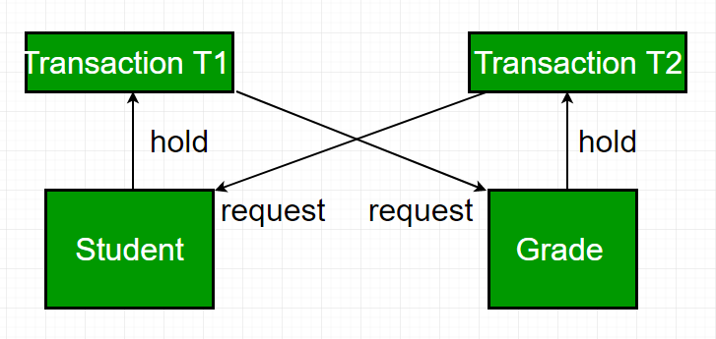
Deadlock (CO4) contd..
In a database, a deadlock is an unwanted situation in which two or more transactions are waiting indefinitely for one another to give up locks.

Slide 77
Deadlock Management
Ignore
Let the application programmer deal with it, or restart the system
Prevention
Guaranteeing that deadlocks can never occur in the first place. Check transaction when it is initiated. Requires no run time support.
Avoidance
Detecting potential deadlocks in advance and taking action to insure that deadlock will not occur. Requires run time support.
Detection and Recovery
Allowing deadlocks to form and then finding and breaking them. As in the avoidance scheme, this requires run time support.

Slide 78
Deadlock Avoidance CO4) contd..
avoid the deadlock rather than restarting or aborting the database
Deadlock avoidance method is suitable for smaller database whereas deadlock prevention method is suitable for larger database.
avoiding deadlock is to apply both row level locking mechanism and READ COMMITTED isolation level.
However, It does not guarantee to remove deadlocks completely.

Slide 79
Deadlock Avoidance
Transactions are not required to request resources a priori.
Transactions are allowed to proceed unless a requested resource is unavailable.
In case of conflict, transactions may be allowed to wait for a fixed time interval.
Order either the data items or the sites and always request locks in that order.
More attractive than prevention in a database environment.

Slide 80
Deadlock Prevention
All resources which may be needed by a transaction must be predeclared.
The system must guarantee that none of the resources will be needed by an ongoing transaction.
Resources must only be reserved, but not necessarily allocated a priori
Unsuitability of the scheme in database environment
Suitable for systems that have no provisions for undoing processes.
Evaluation:
Reduced concurrency due to preallocation
Evaluating whether an allocation is safe leads to added overhead.
Difficult to determine (partial order)
No transaction rollback or restart is involved.

Slide 81
Deadlock Prevention CO4
A deadlock can be prevented if the resources a allocated in such a way that deadlock never occur.
Deadlock prevention mechanism proposes two schemes :
Wait-Die Scheme
Wound Wait Scheme

Slide 82
Wait-Die & Wound-Wait Algorithms
WAIT-DIE Rule:
If T_{i} requests a lock on a data item which is already locked by T_{j}, then T_{i} is permitted to wait iff ts(T_{i})<ts(T_{j}). If ts(T_{i})>ts(T_{j}), then T_{i} is aborted and restarted with the same timestamp.
if ts(T_{i})<ts(T_{j}) then T_{i} waits else T_{i} dies
non-preemptive: T_{i} never preempts T_{j}
prefers younger transactions4
WOUND-WAIT Rule:
If T_{i} requests a lock on a data item which is already locked by T_{j} , then T_{i} is permitted to wait iff ts(T_{i})>ts(T_{j}). If ts(T_{i})<ts(T_{j}), then T_{j} is aborted and the lock is granted to T_{i}.
if ts(T_{i})<ts(T_{j}) then T_{j} is wounded else T_{i} waits
preemptive: T_{i} preempts T_{j} if it is younger
prefers older transactions

Slide 83
Deadlock Detection
If the deadlocks are not avoided then another approach is to detect them when they have occurred and recover from them.
The basic idea is to check allocation against availability for all possible allocation sequences to determine if the system is in deadlocked state.
Once detected there needs to be way to recover several alternatives exist:
Temporarily prevent resources from deadlocked processes
Back Off a process to some check point allowing preemption of a needed resource and restarting the process at the checkpoint later
Successively kill processes until the system is deadlock free.

Slide 84
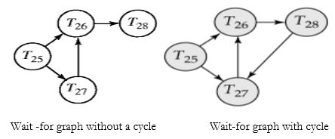
Deadlock Detection
Deadlocks can be described as a wait-for graph, which consists of a pair G=(V,E)G=(V,E),
V is a set of vertices (all the transactions in the system)
E is a set of edges; each element is an ordered pair Ti→Tj.
If Ti→Tj is in E, then there is a directed edge from Ti to Tj, implying that Ti is waiting for Tj to release a data item. - When Ti requests a data item currently being held by Tj, then the edge TiTj is inserted in the wait-for graph. This edge is removed only when Tjis no longer holding a data item needed by Ti.
deadlock-detection algorithm periodically to look for cycles.

Slide 85
Deadlock Recovery
1. Termination of processes
Some victim process is chosen for termination from the cycle of deadlocked processes.
This process is terminated, requiring a later restart
All the resources allocated to this processes are released, so that they may be reassigned to other deadlocked processes
With an appropriately chosen victim process, this should resolve the deadlock.
2. Rolling back processes
In order to rollback a victim process, there needs to have been some previous checkpoint at which time the state of the victim process was saved to stable storage
There must also be an assurance that the rolled back process is not holding any resource needed by the other deadlocked processes at that point
With an appropriately chosen victim process, needed resources will be released and assigned to other deadlocked processes.
This resolves deadlock.

Slide 86
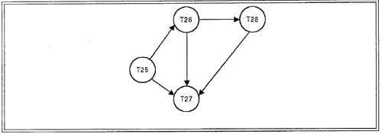
Selection of Deadlock victim
The transaction which have the fewest locks
The transaction that has done the least work
The transaction that is farthest from completion

Slide 87
Distributed Database (CO4)
Distributed Database Management System

Slide 88
Centralized Databases (CO4)
Centralized database required that corporate data be stored in a single central site
Performance degradation as number of remote sites grew
High cost to maintain large centralized DBs
Reliability problems with one, central site

Slide 89
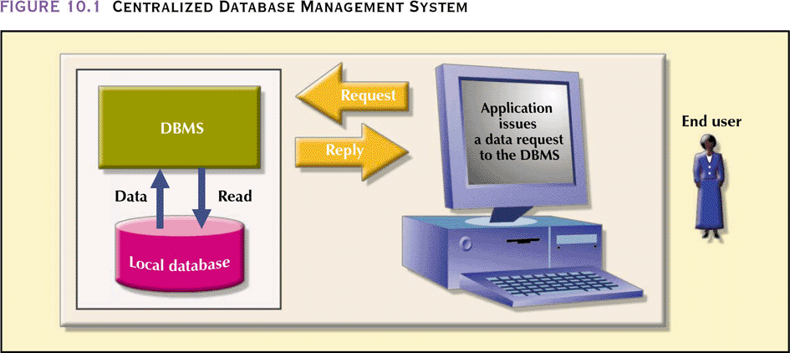
Centralized Databases (CO4)

Slide 90
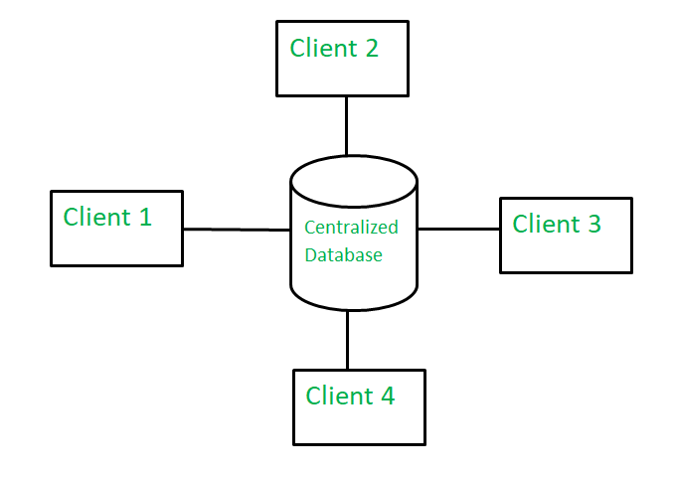
Centralized Databases (CO4)

Slide 91
Challenges in Centralized Databases (CO4)
Dynamic business environment and centralized database’s shortcomings spawned a demand for applications based on data access from different sources at multiple locations
Business operations became more decentralized geographically
Competition at global level
Rapid technological change in computers

Slide 92
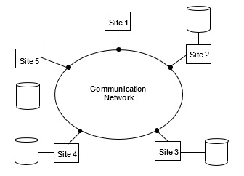
Distributed Databases (CO4)

Slide 93
Distributed Databases (CO4)
Governs storage and processing of logically related data over interconnected computer systems in which both data and processing functions are distributed among several sites
A distributed database system consists of loosely coupled sites that share no physical component
Database systems that run on each site are independent of each other
Transactions may access data at one or more sites

Slide 94
Distributed Databases (CO4)
Advantages
Data are located near “greatest demand” site
Faster data access
Faster data processing
Growth facilitation
Improved communications
Reduced operating costs
User-friendly interface
Less danger of a single-point failure
Processor independence

Slide 95
DDBMS Disadvantages
Complexity of management and control
Security
Lack of standards
Increased storage requirements
Greater difficulty in managing the data environment
Increased training cost

Slide 96
Distributed Processing vs Distributed Database
Distributed processing – a database’s logical processing is shared among two or more physically independent sites that are connected through a network
One computer performs I/O, data selection and validation while second computer creates reports
Uses a single-site database but the processing chores are shared among several sites
Distributed database – stores a logically related database over two or more physically independent sites. The sites are connected via a network
Database is composed of database fragments which are located at different sites and may also be replicated among various sites

Slide 97
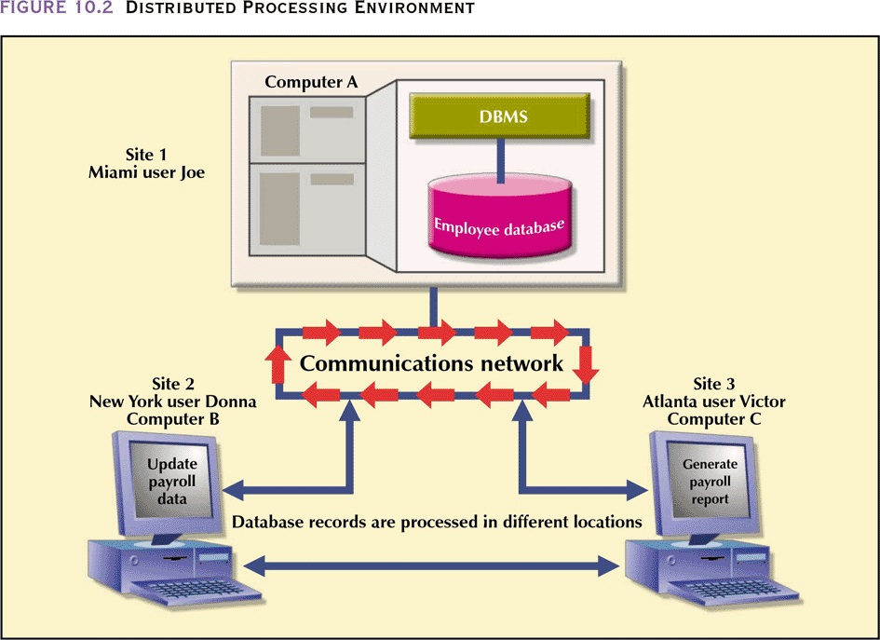
Distributed Processing Environment

Slide 98
Characteristics of Distributed Management Systems
Must perform all the functions of a centralized DBMS
Must handle all necessary functions imposed by the distribution of data and processing
Must perform these additional functions transparently to the end user

Slide 99
Homogeneous Distributed Databases (CO4)
In a homogeneous distributed database
All sites have identical software
Are aware of each other and agree to cooperate in processing user requests.
Each site surrenders part of its autonomy in terms of right to change schemas or software
Appears to user as a single system

Slide 100
Heterogeneous Distributed Databases (CO4) cont..
In a heterogeneous distributed database
Different sites may use different schemas and software " Difference in schema is a major problem for query processing " Difference in software is a major problem for transaction processing
Sites may not be aware of each other and may provide only limited facilities for cooperation in transaction processing

Slide 101
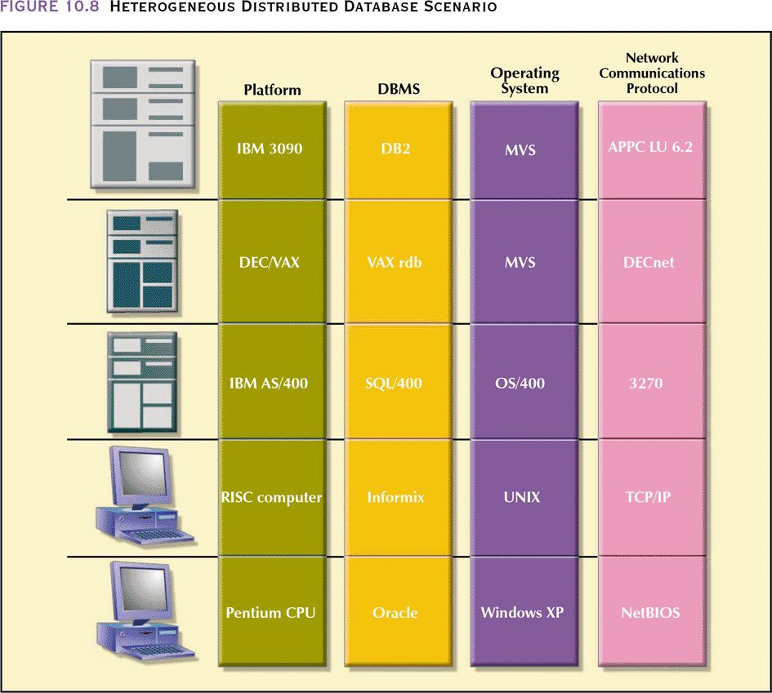
Heterogeneous Distributed Database Scenario

Slide 102
Distributed Data Storage (CO4) cont..
Replication
System maintains multiple copies of data, stored in different sites, for faster retrieval and fault tolerance.
Fragmentation
Relation is partitioned into several fragments stored in distinct sites
Replication and fragmentation can be combined
Relation is partitioned into several fragments: system maintains several identical replicas of each such fragment.

Slide 103
Data Replication
A relation or fragment of a relation is replicated if it is stored redundantly in two or more sites.
Full replication of a relation is the case where the relation is stored at all sites.
Fully redundant databases are those in which every site contains a copy of the entire database.

Slide 104
Data Replication (Cont.)
Advantages of Replication
Availability: failure of site containing relation r does not result in unavailability of r is replicas exist.
Parallelism: queries on r may be processed by several nodes in parallel.
Reduced data transfer: relation r is available locally at each site containing a replica of r.
Disadvantages of Replication
Increased cost of updates: each replica of relation r must be updated.
Increased complexity of concurrency control: concurrent updates to distinct replicas may lead to inconsistent data unless special concurrency control mechanisms are implemented.
One solution: choose one copy as primary copy and apply concurrency control operations on primary copy

Slide 105
Data Fragmentation
Division of relation r into fragments r₁, r₂, …, r_{n} which contain sufficient information to reconstruct relation r.
Horizontal fragmentation: each tuple of r is assigned to one or more fragments
Vertical fragmentation: the schema for relation r is split into several smaller schemas
All schemas must contain a common candidate key (or superkey) to ensure lossless join property.
A special attribute, the tuple-id attribute may be added to each schema to serve as a candidate key.

Slide 106
Horizontal Fragmentation of account Relation
branch_name
account_number
balance
Hillside
Hillside
Hillside
A-305
A-226
A-155
500
336
62
account₁ = σ_{branch_name=“Hillside”} (account )
branch_name
account_number
balance
Valleyview
Valleyview
Valleyview
Valleyview
A-177
A-402
A-408
A-639
205
10000
1123
750
account₂ = σ_{branch_name=“Valleyview”} (account )

Slide 107
Vertical Fragmentation of employee_info Relation
branch_name
customer_name
tuple_id
Hillside
Hillside
Valleyview
Valleyview
Hillside
Valleyview
Valleyview
Lowman
Camp
Camp
Kahn
Kahn
Kahn
Green
1
2
3
4
5
6
7
deposit₁ = Πbranch_name, customer_name, tuple_id (employee_info )
account_number
balance
tuple_id
A-305
A-226
A-177
A-402
A-155
A-408
A-639
500
336
205
10000
62
1123
750
1
2
3
4
5
6
7
deposit₂ = Πaccount_number, balance, tuple_id (employee_info )

Slide 108
Advantages of Fragmentation
Horizontal:
allows parallel processing on fragments of a relation
allows a relation to be split so that tuples are located where they are most frequently accessed
Vertical:
allows tuples to be split so that each part of the tuple is stored where it is most frequently accessed
tuple-id attribute allows efficient joining of vertical fragments
allows parallel processing on a relation
Vertical and horizontal fragmentation can be mixed.
Fragments may be successively fragmented to an arbitrary depth.

Slide 109
Distributed Data Storage (CO4)
Replication
System maintains multiple copies of data, stored in different sites, for faster retrieval and fault tolerance.
Fragmentation
Relation is partitioned into several fragments stored in distinct sites
Replication and fragmentation can be combined
Relation is partitioned into several fragments: system maintains several identical replicas of each such fragment.

Slide 110
Distributed Transactions
Transaction may access data at several sites.
Each site has a local transaction manager responsible for:
Maintaining a log for recovery purposes
Participating in coordinating the concurrent execution of the transactions executing at that site.
Each site has a transaction coordinator, which is responsible for:
Starting the execution of transactions that originate at the site.
Distributing subtransactions at appropriate sites for execution.
Coordinating the termination of each transaction that originates at the site, which may result in the transaction being committed at all sites or aborted at all sites.

Slide 111
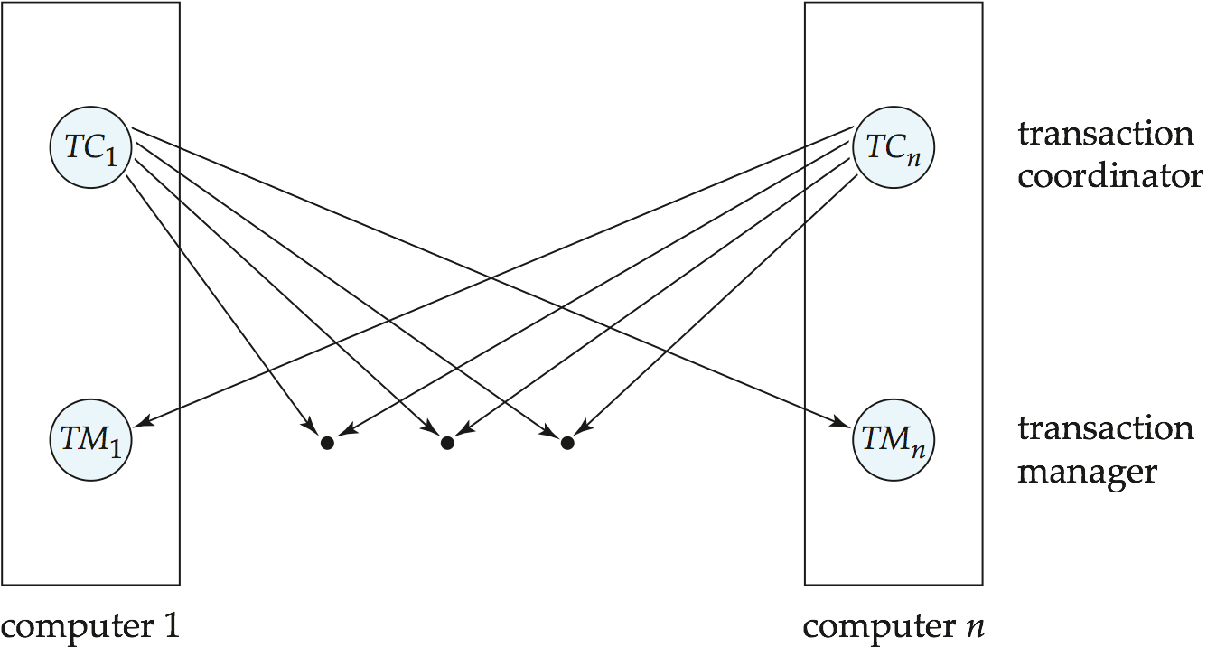
Transaction System Architecture

Slide 112
System Failure Modes
Failures unique to distributed systems:
Failure of a site.
Loss of massages
Handled by network transmission control protocols such as TCP-IP
Failure of a communication link
Handled by network protocols, by routing messages via alternative links
Network partition
A network is said to be partitioned when it has been split into two or more subsystems that lack any connection between them
Note: a subsystem may consist of a single node
Network partitioning and site failures are generally indistinguishable.

Slide 113
Commit Protocols
Commit protocols are used to ensure atomicity across sites
a transaction which executes at multiple sites must either be committed at all the sites, or aborted at all the sites.
not acceptable to have a transaction committed at one site and aborted at another
The two-phase commit (2PC) protocol is widely used
The three-phase commit (3PC) protocol is more complicated and more expensive, but avoids some drawbacks of two-phase commit protocol. This protocol is not used in practice.

Slide 114
Two Phase Commit Protocol (2PC)
Assumes fail-stop model – failed sites simply stop working, and do not cause any other harm, such as sending incorrect messages to other sites.
Execution of the protocol is initiated by the coordinator after the last step of the transaction has been reached.
The protocol involves all the local sites at which the transaction executed
Let T be a transaction initiated at site S_{i}, and let the transaction coordinator at S_{i} be C_{i}

Slide 115
Phase 1: Obtaining a Decision (Voting Phase)
Coordinator asks all participants to prepare to commit transaction T_{i}.
C_{i} adds the records <prepare T> to the log and forces log to stable storage
sends prepare T messages to all sites at which T executed
Upon receiving message, transaction manager at site determines if it can commit the transaction
if not, add a record <no T> to the log and send abort T message to C_{i}
if the transaction can be committed, then:
add the record <ready T> to the log
force all records for T to stable storage
send ready T message to C_{i}

Slide 116
Phase 2: Recording the Decision
T can be committed of C_{i} received a ready T message from all the participating sites: otherwise T must be aborted.
Coordinator adds a decision record, <commit T> or <abort T>, to the log and forces record onto stable storage. Once the record stable storage it is irrevocable (even if failures occur)
Coordinator sends a message to each participant informing it of the decision (commit or abort)
Participants take appropriate action locally.

Slide 117
Handling of Failures - Site Failure
When site S_{i} recovers, it examines its log to determine the fate of
transactions active at the time of the failure.
Log contain <commit T> record: txn had completed, nothing to be done
Log contains <abort T> record: txn had completed, nothing to be done
Log contains <ready T> record: site must consult C_{i} to determine the fate of T.
If T committed, redo (T); write <commit T> record
If T aborted, undo (T)
The log contains no log records concerning T:
Implies that S_{k} failed before responding to the prepare T message from C_{i}
since the failure of S_{k} precludes the sending of such a response, coordinator C₁ must abort T
S_{k} must execute undo (T)

Slide 118
Handling of Failures- Coordinator Failure
If coordinator fails while the commit protocol for T is executing then participating sites must decide on T’s fate:
If an active site contains a <commit T> record in its log, then T must be committed.
If an active site contains an <abort T> record in its log, then T must be aborted.
If some active participating site does not contain a <ready T> record in its log, then the failed coordinator C_{i} cannot have decided to commit T.
Can therefore abort T; however, such a site must reject any subsequent <prepare T> message from C_{i}
If none of the above cases holds, then all active sites must have a <ready T> record in their logs, but no additional control records (such as <abort T> of <commit T>).
In this case active sites must wait for C_{i} to recover, to find decision.
Blocking problem: active sites may have to wait for failed coordinator to recover.

Slide 119
Handling of Failures - Network Partition
If the coordinator and all its participants remain in one partition, the failure has no effect on the commit protocol.
If the coordinator and its participants belong to several partitions:
Sites that are not in the partition containing the coordinator think the coordinator has failed, and execute the protocol to deal with failure of the coordinator.
No harm results, but sites may still have to wait for decision from coordinator.
The coordinator and the sites are in the same partition as the coordinator think that the sites in the other partition have failed, and follow the usual commit protocol.
Again, no harm results

Slide 120
Recovery and Concurrency Control
In-doubt transactions have a <ready T>, but neither a <commit T>, nor an <abort T> log record.
The recovering site must determine the commit-abort status of such transactions by contacting other sites; this can slow and potentially block recovery.
Recovery algorithms can note lock information in the log.
Instead of <ready T>, write out <ready T, L> L = list of locks held by T when the log is written (read locks can be omitted).
For every in-doubt transaction T, all the locks noted in the <ready T, L> log record are reacquired.
After lock reacquisition, transaction processing can resume; the commit or rollback of in-doubt transactions is performed concurrently with the execution of new transactions.

Slide 121
Three Phase Commit (3PC)
Assumptions:
No network partitioning
At any point, at least one site must be up.
At most K sites (participants as well as coordinator) can fail
Phase 1: Obtaining Preliminary Decision: Identical to 2PC Phase 1.
Every site is ready to commit if instructed to do so
Phase 2 of 2PC is split into 2 phases, Phase 2 and Phase 3 of 3PC
In phase 2 coordinator makes a decision as in 2PC (called the pre-commit decision) and records it in multiple (at least K) sites
In phase 3, coordinator sends commit/abort message to all participating sites,
Under 3PC, knowledge of pre-commit decision can be used to commit despite coordinator failure
Avoids blocking problem as long as < K sites fail
Drawbacks:
higher overheads
assumptions may not be satisfied in practice
Notes:
121

Slide 122
Data Transparency
Data transparency: Degree to which system user may remain unaware of the details of how and where the data items are stored in a distributed system
Consider transparency issues in relation to:
Fragmentation transparency
Replication transparency
Location transparency

Slide 123
Directory Systems (CO4)
Typical kinds of directory information
Employee information such as name, id, email, phone, office addr, ..
Even personal information to be accessed from multiple places " e.g. Web browser bookmarks
White pages
Entries organized by name or identifier “
Meant for forward lookup to find more about an entry
Yellow pages
Entries organized by properties
For reverse lookup to find entries matching specific requirements
When directories are to be accessed across an organization

Slide 124
Faculty Video Links, Youtube & NPTEL Video Links and Online Courses Details
Self Made Video Link:
Youtube/other Video Links
https://www.youtube.com/watch?v=5ammL5KU4mo
https://www.youtube.com/watch?v=HAAhn--tZV8
https://www.youtube.com/watch?v=q6ISl9YNxoQ
https://www.youtube.com/watch?v=XCLA0cjk0o8&t=17s
https://www.youtube.com/watch?v=Yu4rIeQZOjo
https://www.youtube.com/watch?v=HhLhIEnsBR0
https://www.youtube.com/watch?v=u3-ciC_TC_k
https://www.youtube.com/watch?v=qH2iYtuJEwQ&t=330s
https://www.youtube.com/watch?v=Jw3jDTAXuAk&list=PL-zLo58JCM3BkfC_wlAosP5VTLV9ObiW1&index=37
https://www.youtube.com/watch?v=IYaxn0qkzUI&t=12s
https://www.youtube.com/watch?v=xCxdBkFX_ww
https://www.youtube.com/watch?v=-r734q6sSa0

Slide 125
Daily Quiz
What is serializability?
What are the types of serializable schedules?
Define recoverability.
What do you understand by log based recovery?
Explain concurrency control.
What do you mean by directory system.
What is distributed data storage?
How do you test serializability?

Slide 126
Weekly Assignment
Explain ACID properties to preserve the integrity of database. CO4
Differentiate between conflict and view serializable schedule. CO4
What do you mean by transaction processing? CO4
What do you understand by distributed databases? Give the various advantages and disadvantages of distributed database management system. CO4
What is a deadlock? How can a deadlock occur? Explain. CO4
What is Log? How is it maintained? CO4
Discuss the salient features of deferred database modification and immediate database modification strategies in brief CO4

Slide 127
MCQ s
In which state, the transaction will wait for the final statement has been executed?
a) Active
b) Failed
c) Aborted
d) partially committed
A Transaction ends
a) only when it is Committed.
b) only when it is Rolled-back
c) when it is Committed or Rolled-back
d) only when it is initialized

Slide 128
MCQ s
Identify the characteristics of transactions a) Atomicity b) Durability c) Isolation d) All of the mentioned
Consider money is transferred from (1)account-A to account-B and (2) account-B to account-A. Which of the following form a transaction? a) Only 1 b) Only 2 c) Both 1 and 2 individually d) Either 1 or 2

Slide 129
MCQ s
A distributed database has which of the following advantages over a centralized database?
a) Software cost
b) Software complexity
c) Slow Response
d) Modular growth

Slide 130
Expected Questions for University Exam
What do you mean by Conflict Serializable Schedule?
What are Distributed Database? List advantage and disadvantage of data Replication And data Fragmentation.
What do you understand by ACID properties of transaction ? Explain in details.
Discuss about deadlock prevention schemes.
Define Transaction and explain its properties with suitable example.
What is schedule? What are its types? Explain view serializable and cascadeless schedule with suitable example of each.
Which of the following schedules are conflicts serializable? For each serializable schedule find the equivalent schedule. S1: r1(x); r3(x); w3(x); w1(x); r2(x) S2: r3(x); r2(x); w3(x); r1(x); w1(x) S3: r1(x); r2(x); r3(y); w1(x); r2(z); r2(y); w2(y)

Slide 131
Summary
Knowledge of transaction processing concept.
Knowledge of how to recover from transaction failures.
Knowledge of distributed database.

Slide 132
Faculty Video Links, Youtube & NPTEL Video Links and Online Courses Details
Youtube/other Video Links
https://nptel.ac.in/courses/106106093/ lecturer 17,18,19,20,21,22,23
https://nptel.ac.in/courses/106105175/ Lectuer 31,32,33,34,35
https://www.youtube.com/watch?v=ldIbItnHX9o
https://www.youtube.com/watch?v=5ammL5KU4mo

Slide 133
MCQ
Collections of operations that form a single logical unit of work are called a) Views b) Networks c) Units d) Transactions
Which of the following is a property of transactions? a) Atomicity b) Durability c) Isolation d) All of the mentioned
Which of the following systems is responsible for ensuring durability? a) Recovery system b) Atomic system c) Concurrency control system d) Compiler system
Which of the following systems is responsible for ensuring isolation? a) Recovery system b) Atomic system c) Concurrency control system d) Compiler system

Slide 134
Weekly Assignment 4.1
Q1. Which of the following schedules is (conflict) serializable? For each serializable schedule, determine the equivalent serial schedules. CO6
r1(X); r3(X); w1(X); r2(X); w3(X);
r1(X); r3(X); w3(X); w1(X); r2(X);
c) r3(X); r2(X); w3(X); r1(X); w1(X);
d) r3(X); r2(X); r1(X); w3(X); w1(X)
Q2. When two operations are said to be conflict? CO6
Q3. Define the terms : Lock Point, Strict 2PL, Starvation CO6
Q.4 What is Deadlock? How are deadlock handled? What is deadlock prevention? What is deadlock detection and Recovery? Explain with an Example. CO6
Q5. Define the distributed database. How data is stored in distributed system. Explain the protocol used in concurrency control. CO4

Slide 135
Glossary Questions
Fill in the blanks using given Glossary
Keywords: Consistency, Isolation, Dynamic SQL, Stable Storage, Cluster, Time stamps, Lock Manager, Deadlock, Rollback
_______________ provides option for entering SQL queries as execution time, rather than at the development stage.
For a transaction to be durable, its changes need to be written to ________ storage.
A ______ file system is software that enables multiple computers to share file storage while maintaining consistent space allocation and file content
All lock information is managed by a __________ which is responsible for assigning and policing the locks used by the transactions.
____ means that the data used during the execution of a transaction cannot be used by a second transaction until the first one is completed.
The deadlock state can be changed back to stable state by using _____________ statement
A system is in a ______ state if there exists a set of transactions such that every transaction in the set is waiting for another transaction in the set.
. __________ states that only valid data will be written to the database.

Slide 136
Old Question Papers
https://drive.google.com/drive/u/0/folders/1gWUEwo7Ztpxs4smy34fl9jWQrx4AKpkC

Slide 137
Old Question Papers
http://www.aktuonline.com/papers/btech-cs-5-sem-data-base-management-system-KCS501-2020.pdf
http://www.aktuonline.com/papers/btech-cs-5-sem-database-management-system-rcs-501-2018-19.pdf
http://www.aktuonline.com/papers/btech-cs-5-sem-database-management-system-ncs-502-2017-18.pdf
http://www.aktuonline.com/papers/btech-cs-5-sem-database-management-system-ncs-502-2016-17.pdf

Slide 138
Expected Questions for University Exam
Discuss how the log file is a fundamental feature in any recovery mechanism? Explain forward and backward recovery and describe how the 1og file is used in forward and backward recovery.
Discuss the significance of the write-ahead log protocol ? Discuss about the check points which affect the recovery protocol ?
Discuss the procedure of deadlock detection and recovery in transaction.
Define recoverable schedule? Explain the recoverable of schedule desirable? Are there any circumstances under which it would be desirable to allow non recoverable schedule?
Explain the various states of transaction?
What do you mean by serializability? Discuss the conflict and view serializability with example.

Slide 139
References
Korth, Silbertz, Sudarshan,” Database Concepts”, McGraw Hill
Date C J, “An Introduction to Database Systems”, Addision Wesley
Elmasri, Navathe, “ Fundamentals of Database Systems”, Addision Wesley
Thank You

